Slide 1
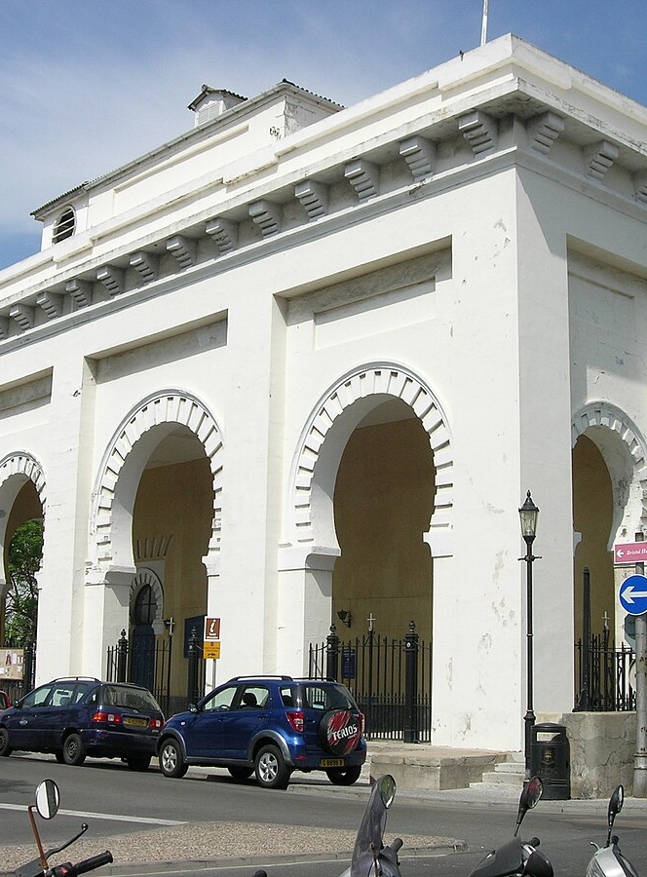
Gibraltar Archdeaconry Synod 2026
Archdeacon’s Report

Slide 2
Giving thanks for this Synod ……
Thankyou to Synod speakers and contributors
  Bp Andrew for our Synod address and Chapter input
  Sal McDougall, Rodney Middleton for excellent Bible studies
  Diocesan staff – Ella Sibley, Grace Fagan-Stewart, Andy Munroe, Susi Doherty, Chris Lynch, Mervyn McCullagh
  Mini meeting leaders - Ian Bendrey, Celia Patterson, Audrey Rainbow
  Spanish and Portuguese Section chairs – John Chapman and Rob Kean
  Bp Victor from Peru, and to Deborah Chapman
  To all who have led worship, read, preached, presided, lead us in intercession, played music
  To the Hotel staff – who have supported us
  In partcular to all of those who have organised things behind the scenes – Paul Strudwick, Vicky Field, Joan Berry, Rob Kean, Audrey Rainbow

Slide 3
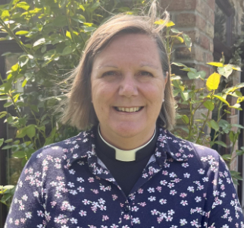
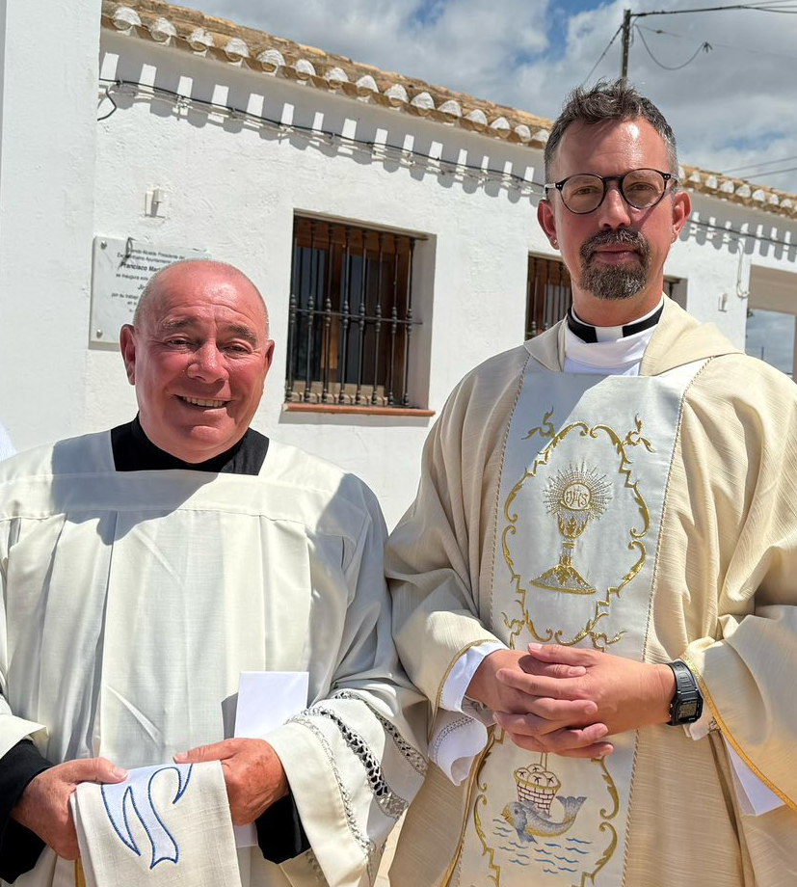
Giving thanks for Archdeaconry activity …….
The ministry and mission of 27 Christian communities in Gibraltar, Andorra, Morocco, Portugal and Spain – for clergy licensed and PtO, for Readers, for congregation members
For appointment processes during 2025
        Pueto Pollensa – Rev’d Sara Davies
        Costa Almeria – Rev’d Denis Bradshaw
        Costa Blanca – preferred candidate
        Ibiza
        Nerja
        Tangier
        Tenerife South
        Lanzarote
        Madeira

Slide 4
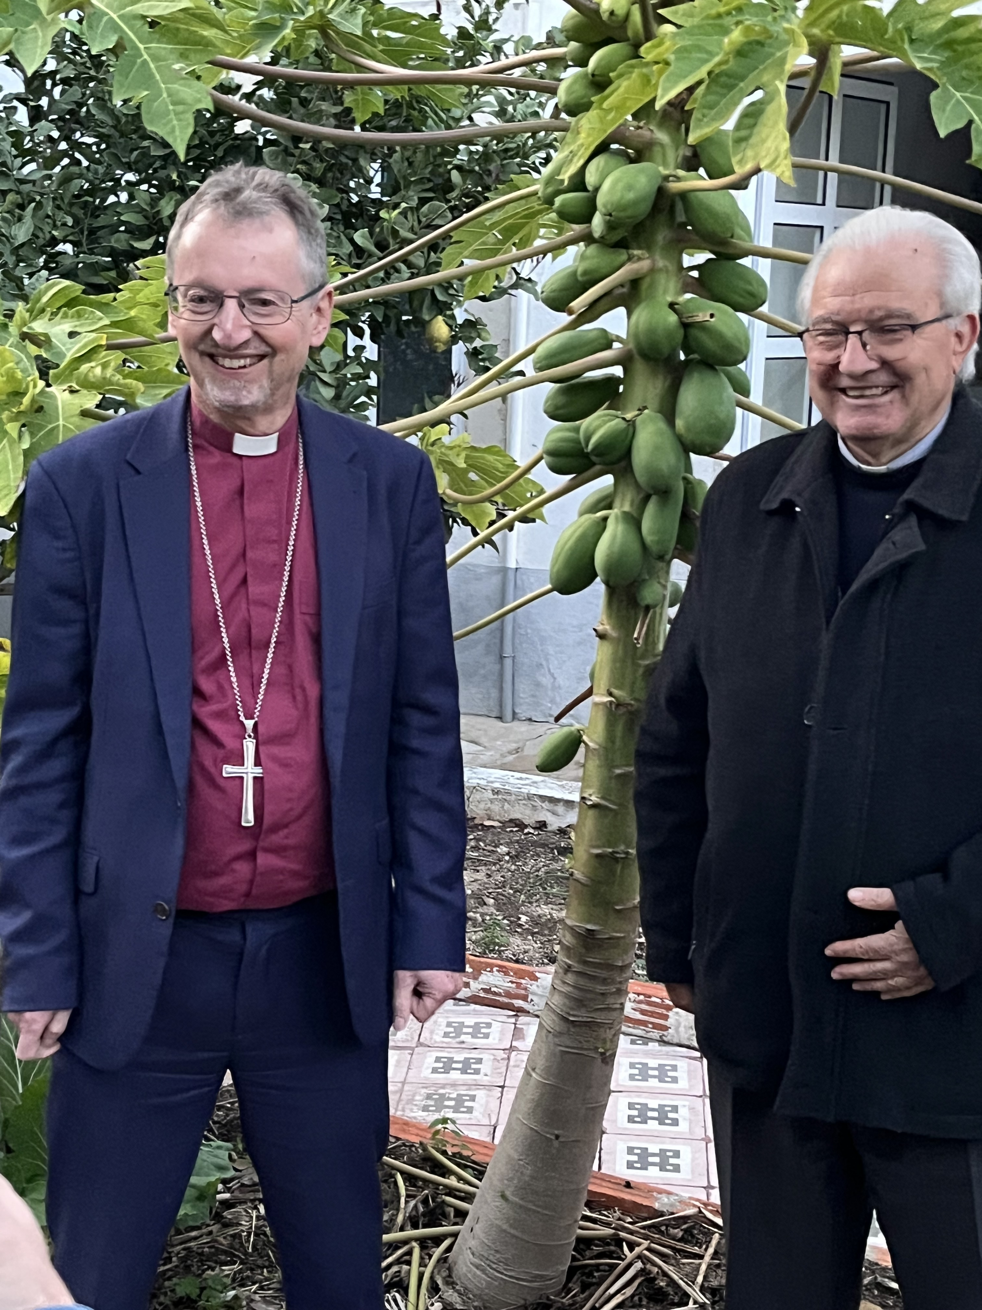
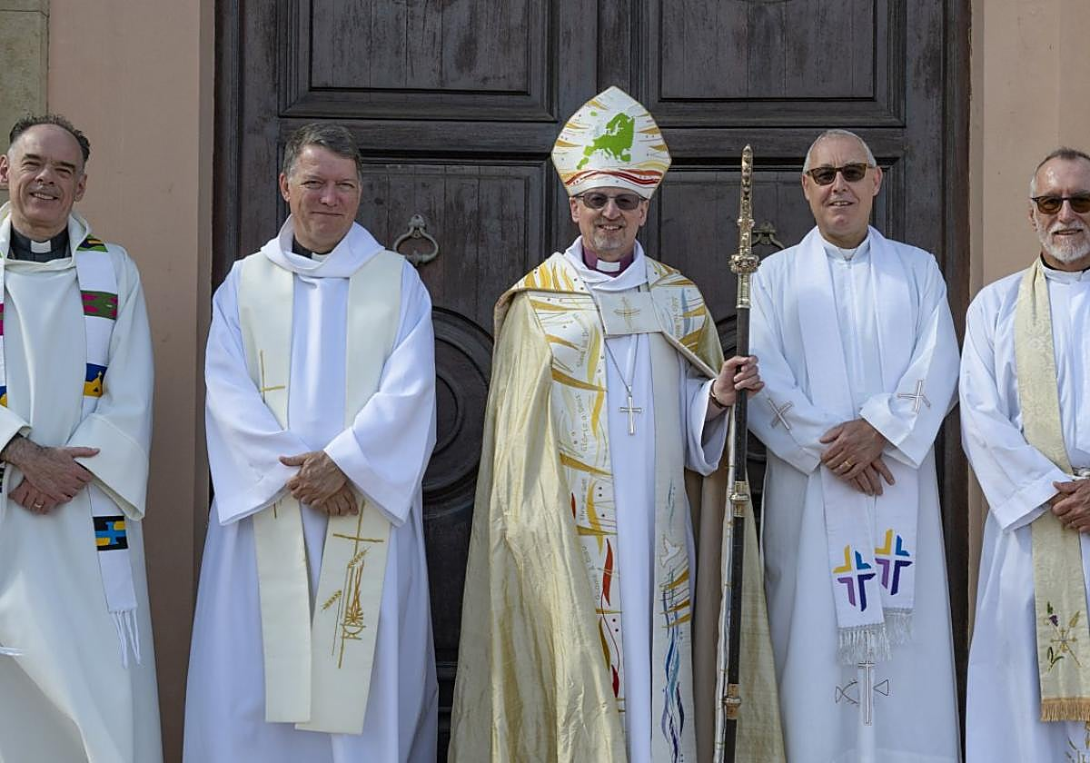
Giving thanks for more Archdeaconry stuff ……
Chrism Mass at St.George’s Madrid
Episcopal Tours
  Algarve in December
  Costa del Sol in October
  Ordinations in Lisbon and Barcelona in July
  Gibraltar in April for Easter
Bp Robert with
Bp Manuel of Faro
With clergy from Costa del Sol

Slide 5
Archdeacon’s Visits
Tenerife Madeira
Costa Brava Costa del Sol East
Madrid Malaga
Gibraltar Costa del Sol West
Brussels / Waterloo Algarve
Canterbury / London Ibiza
Diocesan Synod in Cologne Puerto Pollensa
Lisbon
Barcelona Various in Italy / Malta
Menorca Palma de Mallorca

Slide 6
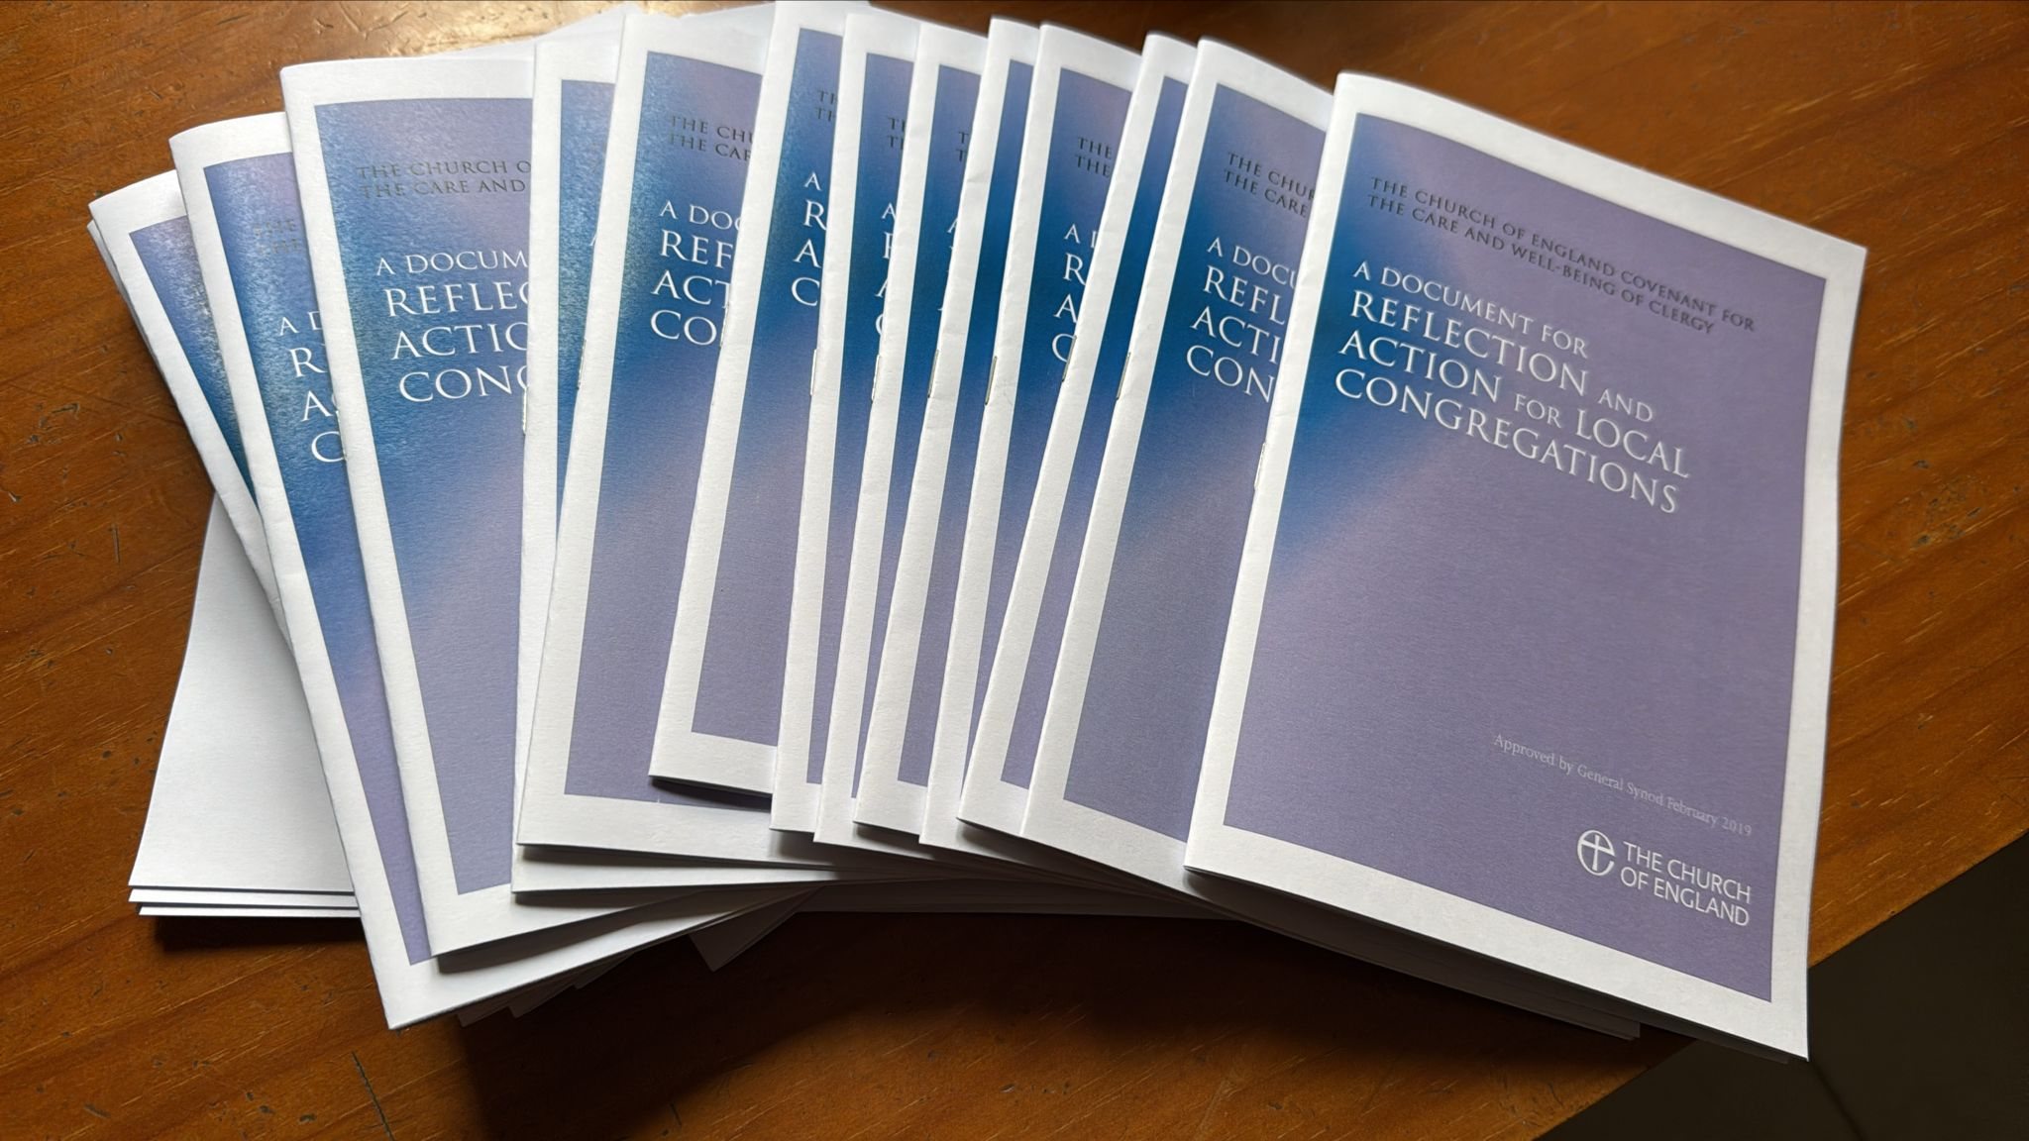
Challenges and Opportunties
Increasing sense of conflict
Making good appointments
Care for clergy – new Ministerial Development, part time/PtO clegy needs
Pastoral care for chaplaincies in vacancy
Nurturing and maintaining safe spaces
Engaging with the national C of E and Anglican Communion on issues that affect us and our chaplaincies

Slide 7
Archdeaconry Synod – Online vs In person
Current situation
Synod asked Standing Committee to make a decision
Of the triennium – 1st and 3rd Synod in person, middle Synod online

